Slide 1
Jash Event
Presented by :
Yash M Patel [151280107042]
Jaimin L Patel [151280107038]

Slide 2
Introduction
This project is based on an Event Management system. In this project there are all types of events. All events are divided into the different categories. From our website the customer see the event handlers and check their prices easily. Also book the event handlers from our website. Customer will also pay through our website.

Slide 3
Purpose of project
From our website people can easily find the event handlers by their requirements.
Also people done their payment in our website.
Customers will not need to go to any shop.
Also customers read the review before they book any event handler.
Customer will also give his/her feedback.
Customer will chat with the event handler.

Slide 4
Comparison
Justdial, sulekha is as similar as our website.
But into the other website people can direct call the event handler so some people done fake calls.
In other website event handler can not describe their own events.
In other websites they customer can’t book event handler from the website.

Slide 5
Modules
There are 4 types of modules in our websites.
Home page
Customer login
Event handler login
payment

Slide 6
Advantages
From our website customer will have to request the event handler for contact otherwise they sent message in our chatroom so the fake call is stop.
Customer can also book event handlers from our website and also done safe payment into the website.
In our website event handler describe their own events to show customer.

Slide 7
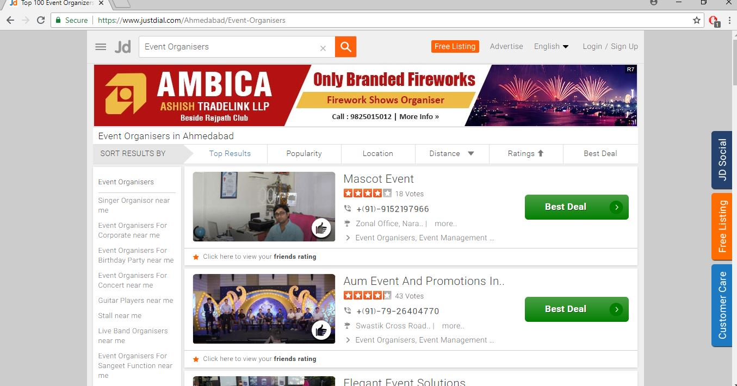
References
www.justdial.com

Slide 8
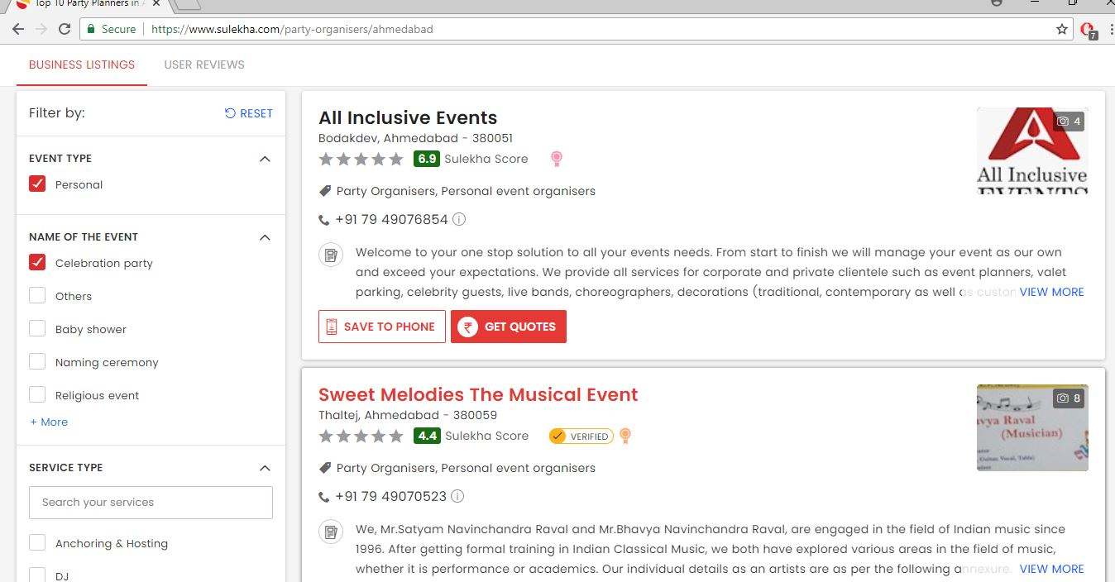
www.sulekha.com

Slide 9
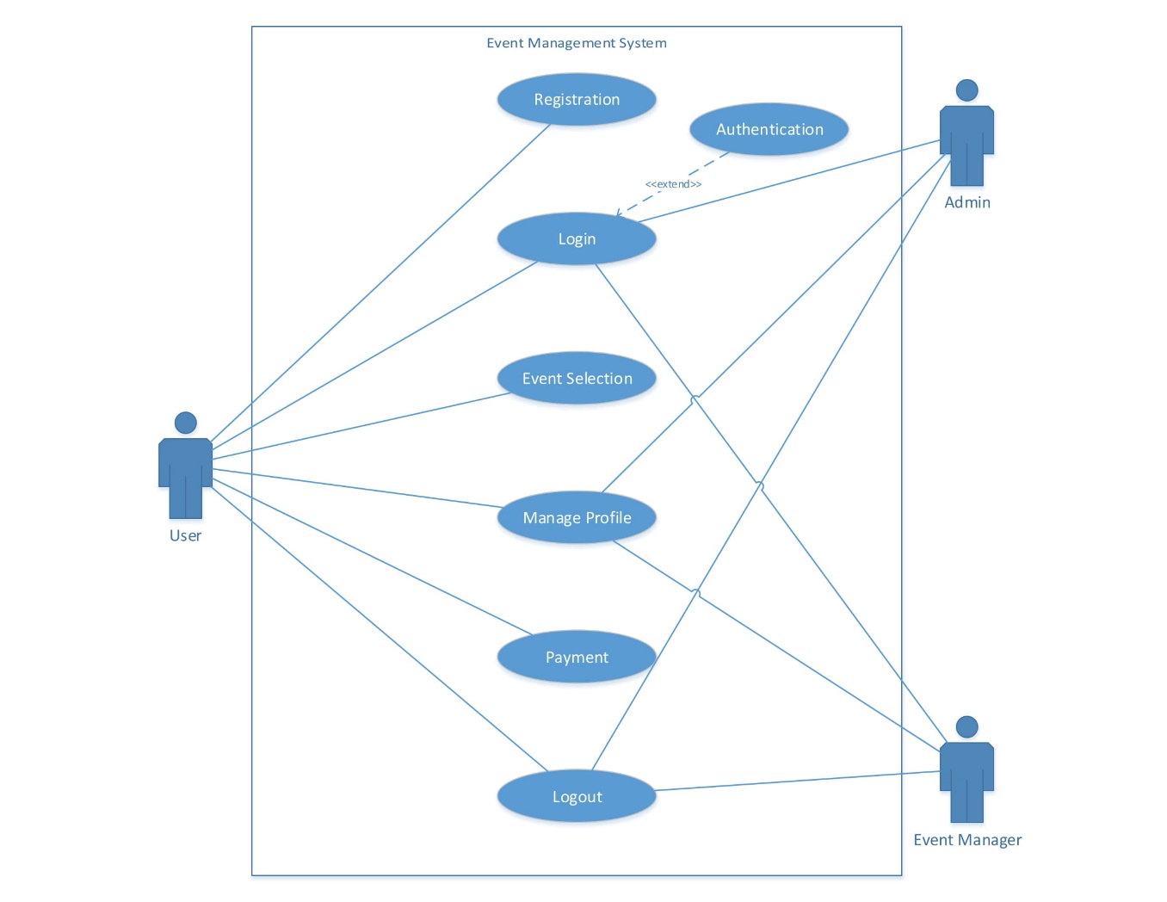
Use case diagram

Slide 10
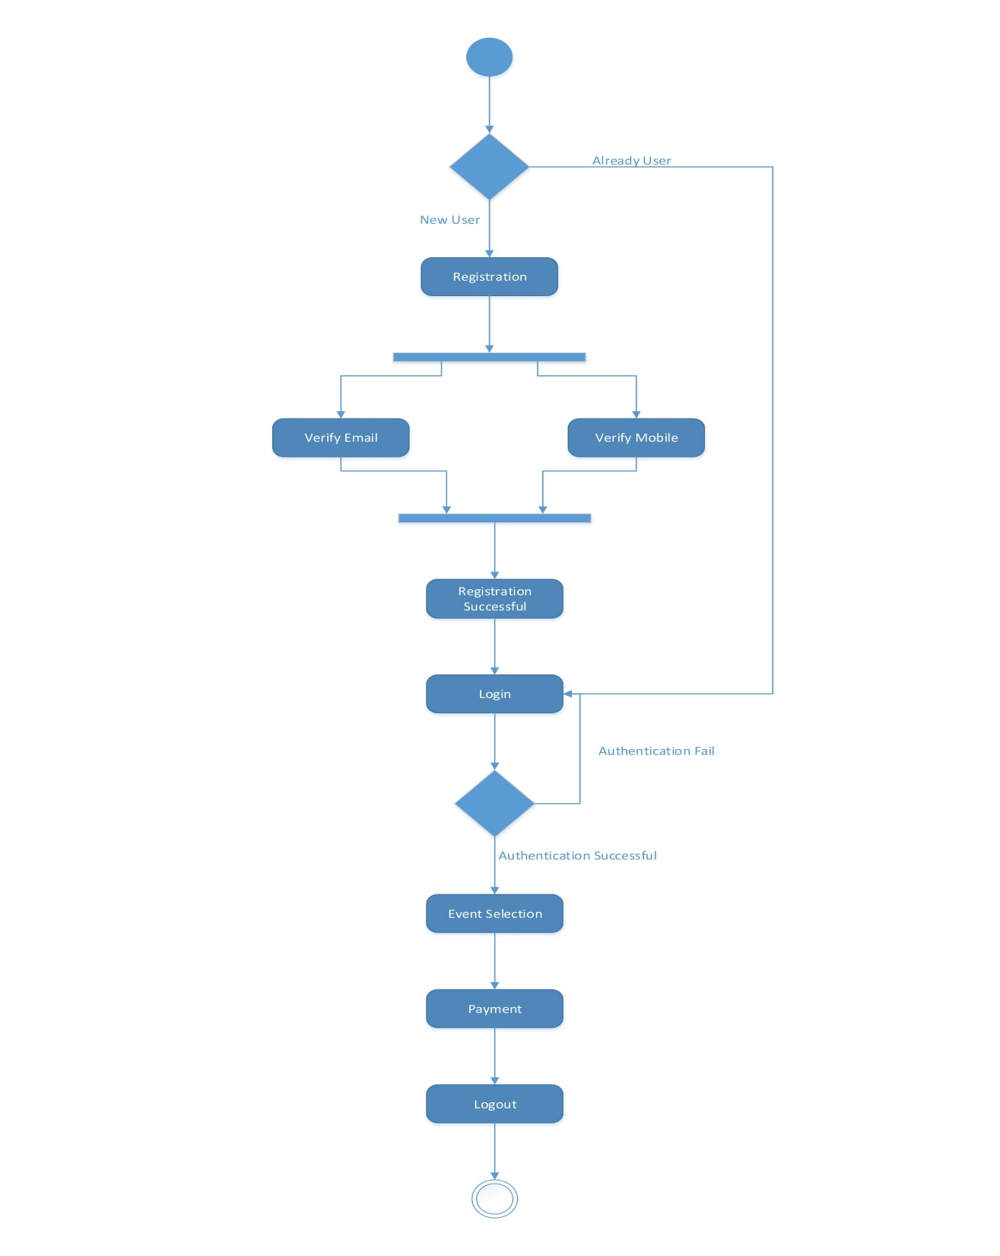
Activity diagram

Slide 11
Thank You

